Slide 1
Video Style Transfer
Roberto Halpin (rgh224), Shirley Thomas (smt244), Meiqi Wu (mw849)

Slide 2
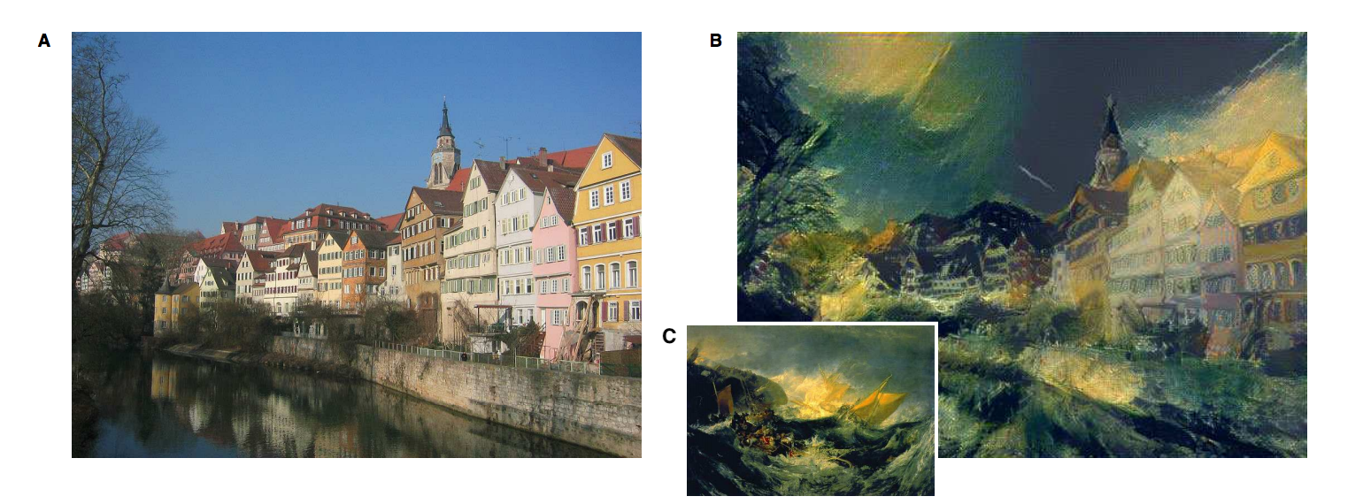
Overview of Style Transfer

Slide 3
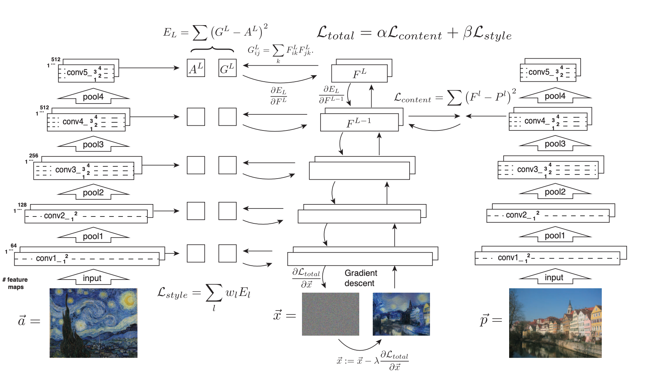
Frame-wise method (Gatys et al.)
Notes:
Also has added regularization loss
Two main problems:
Inefficient
2 mins per frame on CPU
No consistency in videos
Need some kind of loss to keep consecutive frames consistent

Slide 4
Demo

Slide 5
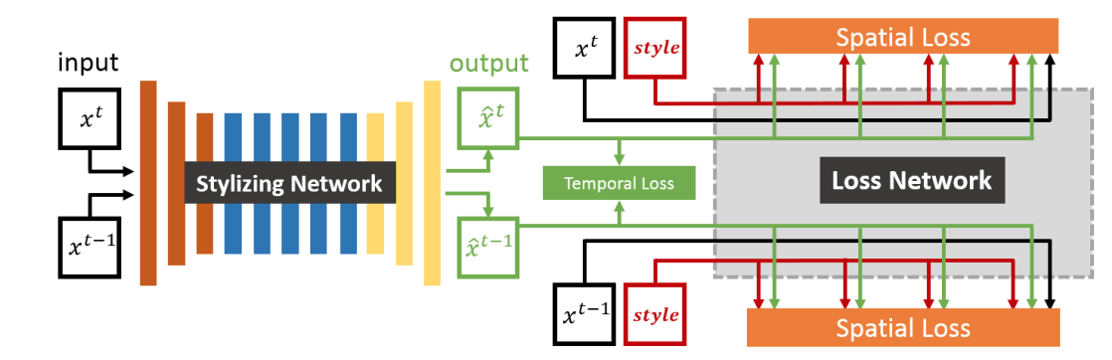
Solution (Huang et al.)
Notes:
Supervised approach, condition on style image
Lightweight tainable network for quick inference
34 videos in training set
Has same content, style, and regularization loss but adds temporal
Real time inference

Slide 6
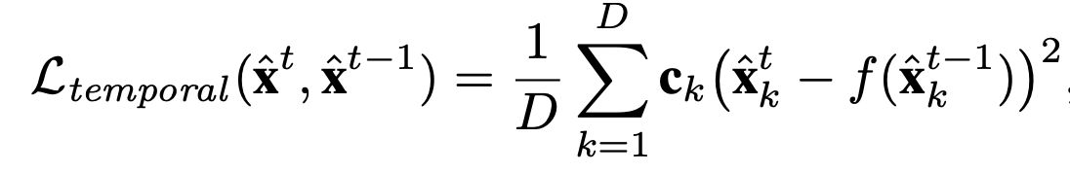
New Temporal Loss
Notes:
Precomputed optical flow warps previous frame, compute MSE between warped stylized frame and second stylized frame
Optical flow
HxWx2 tensor with velocity in x and y direction for every pixel (where this pixel should be in the next frame)
Ck corresponds to pixel weighting if they are occluded or at motion boundary
Occluded looks at differences between forward and backward optical flow
Motion boundary looks at gradients of optical flow maps themselves
D = CxHxW

Slide 7
Difficulties in implementation
Temporal Loss implementation
Precomputing optical flow for every consecutive frame for all videos
Verifying correctness of warped frames
GPU Port
Ran into CUDA Memory issues.
Batch size could not be increased to speed up training.
Notes:
Temporal Loss
Paper’s cited method used Caffe, had trouble compiling due to python and CUDA versions, other modern OF methods used complex data loader methods that we would have to modify for our data, ended up using OpenCV dense OF (Gunner Farneback)
No easy way to sanity check the warped frames using optical flow, especially since the difference between most consecutive frames is small and the correct identification of occluded regions and motion boundaries
Need dataset with ground truth OF (like Sintel) to verify optical flow correctness, not straightforward to implement sanity check
GPU port
Not as simple as transforming CPU code to work on GPU

